Slide 1

The Unemployment Factor
Africa Union Commission
Economic Affairs
November 23, 2011
By: Lulit Bereda

Slide 2
Outline
Unemployment Figures in Africa
Causes of Unemployment
Solutions to the Unemployment problem
Unemployment and sustainable Economic Growth
Conclusion

Slide 3
Unemployment Figures in Africa
“Africa achieved relatively high growth rates in the first decade of the 21st century, culminating in a continent-wide average growth rate of 6.1 per cent in 2007” (Economic report of Africa , 2010)
The rapid growth resulted from
increased investment
foreign direct investment (FDI)
inflows of other foreign resources
macroeconomic stability and better economic management

Slide 4
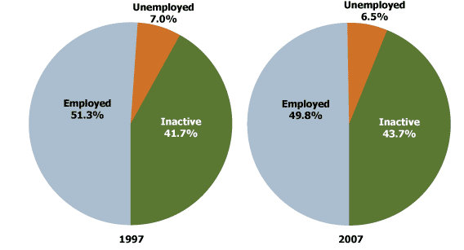
Unemployment Figures in Africa

Slide 5
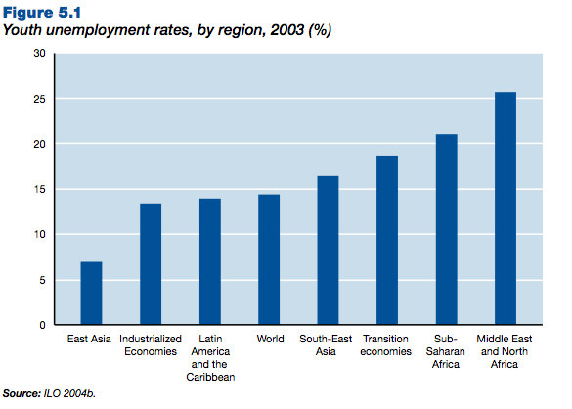
Unemployment Figures in Africa

Slide 6
Unemployment Figures …
In 2009, the youth unemployment rate in North Africa amounted to 23.7% .
In sub- Saharan Africa, 60% of the unemployed are youth, and an average of 72% of youth live on less than US$2 a day.
Since the onset of the economic crisis, between 2007 and 2009, youth unemployment increased by 7.8 million at the global level (1.2 million in 2007/08 and 6.6 million in 2008/09).

Slide 7
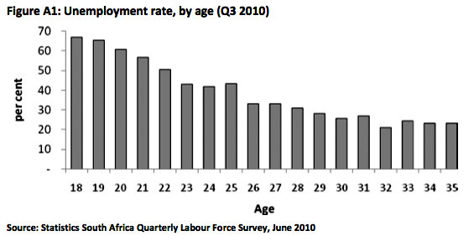
Unemployment Figures in South Africa

Slide 8
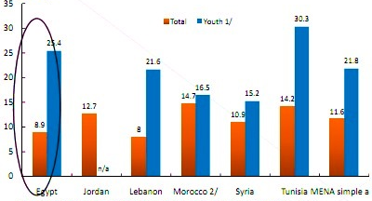
Unemployment Figures in North Africa (2008)

Slide 9
Unemployment Figures in West Africa
Country | Total Pop in Millions | % of youth (0-14) | % of youth (15-24) | % of youth (25-29) | Unemployed youth
Cote d'Ivore | 18.2 | 45.10% | 22% | 7.60% | 31%
Liberia | 3.3 | 44.80% | 19.70% | 7.50% | 88%
Sierra leone | 5.5 | 43.40% | 18.80% | 7.30% | 60%
Source: United Nations Office in West Africa (2007)

Slide 10
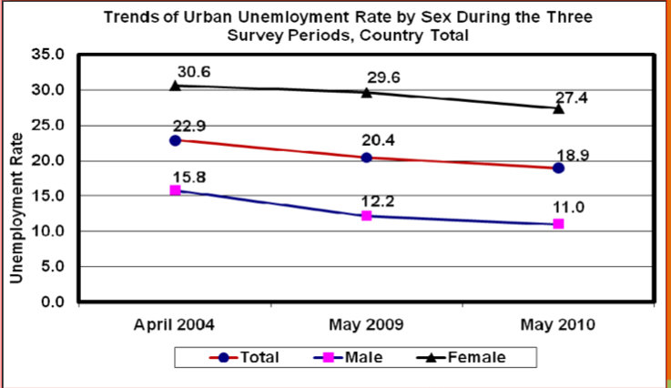
Unemployment Figures in East Africa (Ethiopia)
Source : Central Statistics Agency

Slide 11
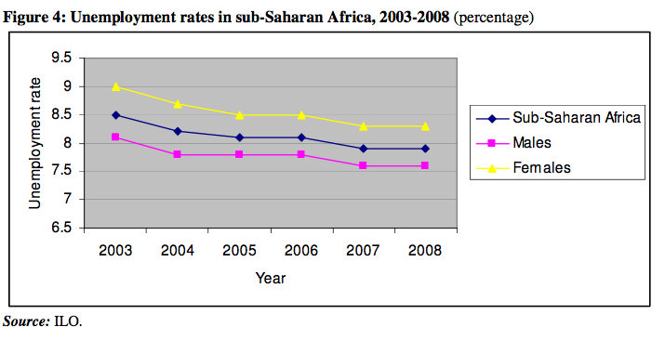
Unemployment Figures in Africa

Slide 12
Causes of Unemployment
Demographic challenges
Enrollment rates and quality of education
Health Status
The Global Financial crisis
Migration Patterns

Slide 13
Causes …
Demographic challenges
One of the major causes of unemployment is the exponential growth rate of the population, especially the youth. Africa has the fastest-growing and most youthful population in the world.
“Youth make-up as much as 36 % of the total working-age population and 3 in 5 of Africa youth are unemployed”. (ILO)

Slide 14
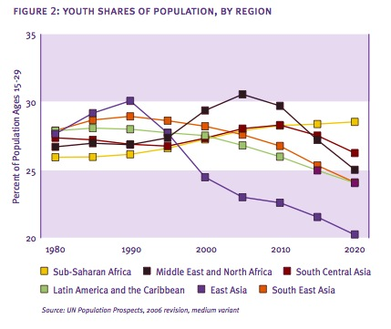
Causes …

Slide 15
Causes…
2. Enrollment rates and quality of education
“Lower enrollment rates, coupled with low completion rates, low quality of education and a failure to orient curricula with the needs of the private sector have contributed to the mismatch of skills of youth labor markets in Africa” (UNECA)
Youth literacy in Sub-Saharan Africa is 76.8 %, (UNDP 2004)

Slide 16
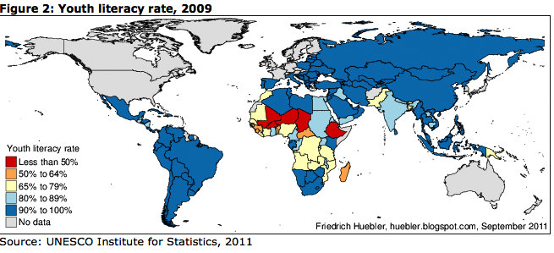
Causes …

Slide 17
Causes …
3. Health Status
One of the major problems facing Africans is lack of health and medical services limiting the percentage of population that would otherwise be employed.
At 45.2 years, life expectancy in Sub-Saharan Africa is among the lowest in the world.
On top of this problem, Sub-Saharan Africa has the highest share of young people living with HIV: nearly two- thirds reside in the region.

Slide 18
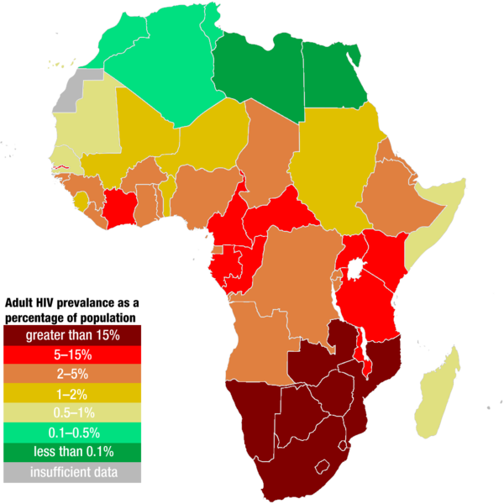
Causes of Unemployment
Estimated HIV infection rate in Africa in 2007

Slide 19
Causes …
4. The Global Financial crisis
The current global crisis has exacerbated the unemployment rates in Africa.
Foreign Direct Investment (FDI) in Africa has drop by roughly 26.7% in 2009, compared to 2008. (IMF)
According to the African Development Bank, the GDP growth of African States fell from an average of 5.6% during 2001 – 08 to 2.5% in 2009.

Slide 20
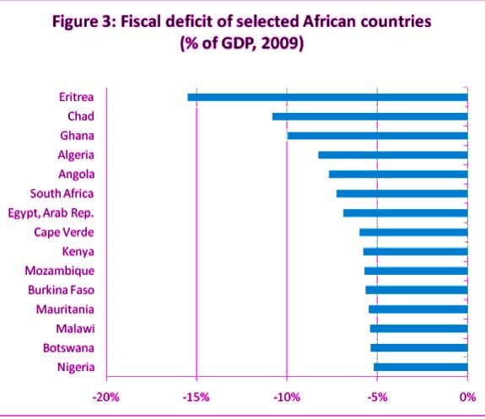
Causes of Unemployment

Slide 21
Causes …
5. Migration Patterns
Mass migration of young people from rural areas to urban cities contributes to the rising unemployment rate.
Empirical analyses show that rural youth migrate to urban areas to find better educational and work opportunities and a way out of poverty.
Yet, despite the earned income, the mass migration of youths to urban areas does not mean that all will find employment

Slide 22
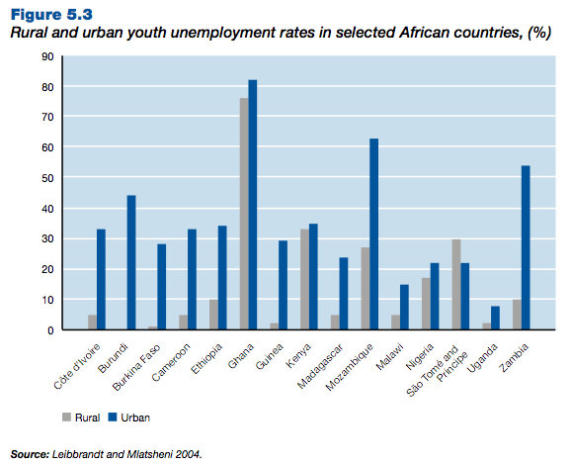
Causes of Unemployment

Slide 23
Solutions to the Unemployment problem
Education and training
Effective agricultural policies
Private Sector involvement
Public Works programs
Employment subsidies
Promoting self-employment and entrepreneurship

Slide 24
Solutions to the Unemployment problem
Employment subsidies
The objective of a targeted subsidy is to improve the employment prospects and opportunities for a particular group by reducing the costs of employing the targeted group relative to other groups, making them more attractive for firms to hire them.

Slide 25

Solutions …
Youth employment subsidy programs also lower the relative cost of hiring a young person (while leaving the wage the employee receives unaffected) and therefore increases demand for young workers.

Slide 26
Solutions …
Education and training
The low level of education of young people is the significant factor that causes the rising unemployment rates, there should be improvements to the education and training provided to young people, with a greater focus on vocational skills.

Slide 27
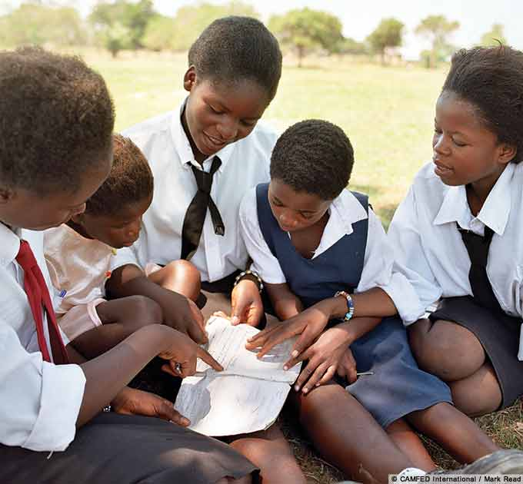
Solutions …
Educational subsidy programs should also be implemented in order to increase the enrollment rates of the rural and urban youth population.

Slide 28
Solutions …
Effective agricultural policies
One of the main focuses of African governments should be on effective agricultural policies to prevent the ongoing migration from rural areas to urban centers, which is a major factor in the rapid growth of unemployment

Slide 29

Solutions …
it is necessary to create jobs that will increase rural income and welfare and, thereby, retain young people.
Their needs to be an increase in investments in irrigation, water resources management, research and extension, rural public services, use of improved seeds, fertilizers and better agricultural practices.

Slide 30
Solutions …
Private Sector involvement
Public-private partnerships are essential for overcoming supply constraints in education
A linkage between the formal education sector and the private sector will ensure that curricula are demand-driven, helping to improve the skill match between school leavers and the demands of employers.

Slide 31
Solutions …
Public Works programs
Are a broad category of projects, financed and constructed by the government, for recreational, employment, and health and safety uses in the greater community.
Public works programs can be useful for revamping the economic indicators and establishing growth and development.

Slide 32

Solutions …
For E.g. , the Senegalese government, set up a US$33 million public works program that targeted the growing number of unemployed youth.
During the first phase of the program around 80,000 jobs were created for young people in 416 projects in small-scale enterprises.
Source : UNECA

Slide 33
Solutions …
Promoting self-employment and entrepreneurship
Self-employment could be an important generator of jobs and ultimately economic growth.
Even though young people lack the experience and skills to become entrepreneurs, they are also capable of developing innovative and creative ideas.

Slide 34

Solutions …
young people can be given help with training, mentor support, support with developing networks and access to credit and office facilities

Slide 35
Unemployment and sustainable Economic Growth
Long term strategies need to be implemented in order to solve the unemployment problem.
Investment that will transform the structure of African economies from reliance on low-employment-generating natural resource extraction to high-employment labor-intensive manufacturing, agro-industry and service provision.

Slide 36

Unemployment and sustainable Economic Growth
Factor markets will have need to be reformed to encourage the use of labor-intensive production techniques, in contrast to current policies, which favor capital-intensive techniques

Slide 37
Conclusion
There are no easy solutions to the problem of rising unemployment rates in Africa
In order to bring about change and find a solution, the States of the continent need to unite and include employment as a part of the growth strategy for every African country.

Slide 38
The End
African Union Commission
November 23, 2011

