Slide 1

Longhi Advisory Partners
Lille
France
Crise Financière Internationale et Emploi en Afrique:
La Macroéconomie Mondiale
Global Macroeconomics and Empoyment
Second Congress Of African Economists
Abidjan, Côte d’Ivoire
November 24-26, 2011
Prof. Désiré Mandilou
Université des Sciences & Techniques de Lille 1 – France
Email: mandild@yahoo.com

Slide 2
RNB, $, €, Afrique ?
ACL
ACR
CPE
3500 $
6
1

Slide 3
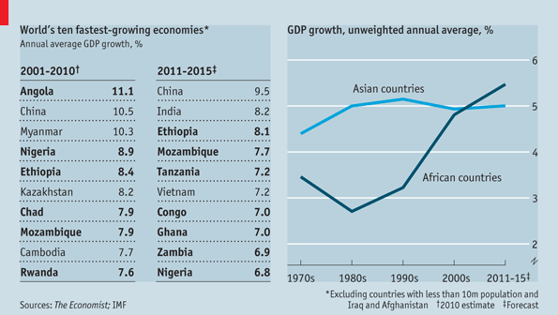

Slide 4
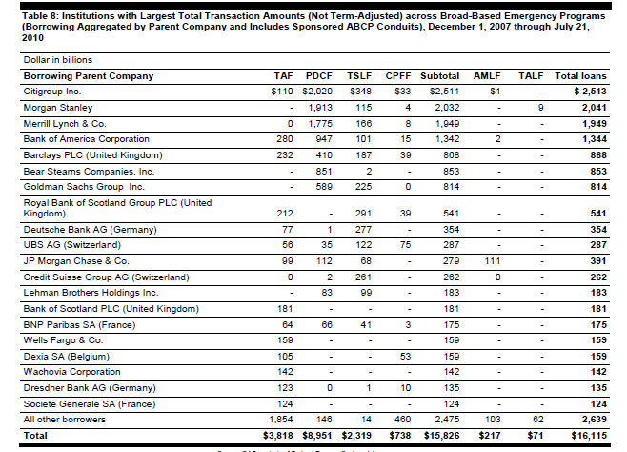
Source: Report to Congressional Addressess, by GAO, United States Government Accountability Office, July 2011 – First Audit of the Federal Reserve System

